Slide 1
Aim: To develop a model that helps them retain customers of a telecom provider as customers are quick to switch to different providers based on the benefits offered by many other providers
Methodology:
Data cleaning and exploratory analysis
Feature selection using data exploration and visualization
Model building to predict churning of customers
Model deployment using Flask API
Dataset details
Churn.- Customers who left within the last month
Details of services used by customers — phone, multiple lines, internet, online security, online backup, device protection, tech support, and streaming TV
Customer account information - contract, payment method, paperless billing, monthly charges, and total charges.
Demographics information about customers — gender, age range, and if they have partners and dependents.

Slide 2
Data attributes and their data types
Data attribute | Data type | Data attribute | Data type
Customer ID | category | StreamingTV | category
gender | category | StreamingMovies | category
SeniorCitizen | category | TotalCharges | int64
Partner | category | PaperlessBilling | category
Dependents | category | MonthlyCharges | int64
tenure | int64 | PaymentMethod | category
PhoneService | category | Contract | category
MultipleLines | category | Churn | category
InternetService | category
OnlineSecurity | category
OnlineBackup | category
DeviceProtection | category
TechSupport | category

Slide 3
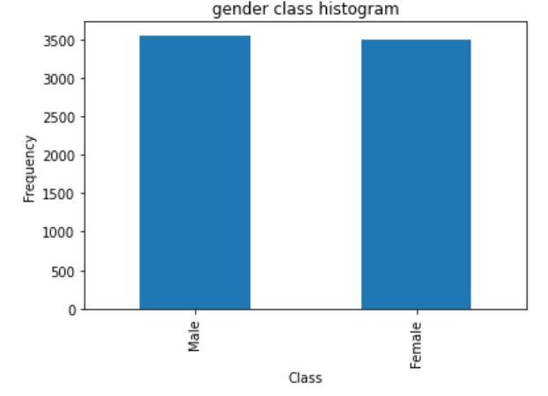
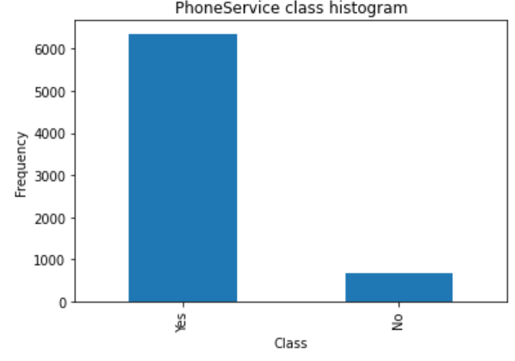
Data Exploration

Slide 4
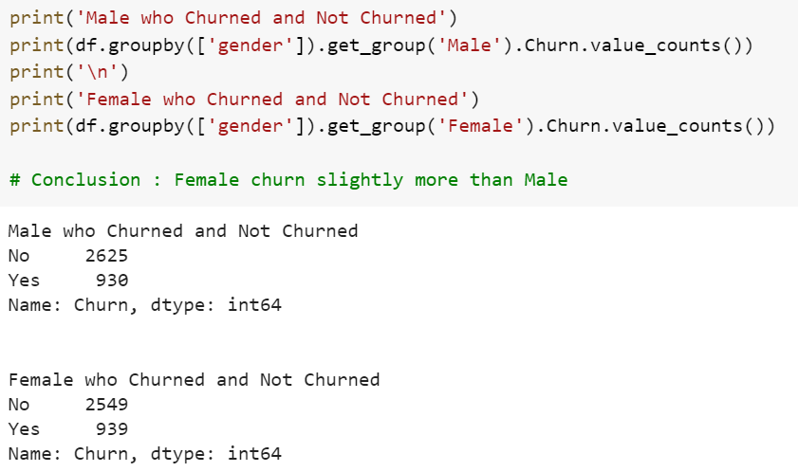
Group Based Analysis

Slide 5
Based on the data exploration we get the following insights
Month to month contract is more likely opted by customers.
Tech Support is not taken by maximum customers and customers who do not have Internet Service do not belong to any category.
Fiber optic cable is most common internet service. There is large population which doesn’t have internet service as well.
Senior Citizens churn slightly more than Non-Senior Citizens
Non-Dependent Customers churn more than Dependent Customers
Customers with Fiber optic Internet Service churn highest as compared to DSL and no Internet Service customers
Customers with No Online Security Churn way more than customers that do have Online Security.
People having month to month contract are biggest churners.
Churn is an imbalanced class with most of the customers as Non-Churners.

Slide 6
Feature Selection of attributes for model building
We use sampling technique called SMOTE(Synthetic Minority Oversampling Technique) to create synthetic data points for minority class (Yes) which is also used for feature selection
We use one-hot encoding for our feature selection because the models don’t interpret categorical data. Hence, we need to convert them into non-categorical data and we assign numbers using the function:
replaceStruct = {"Churn": {"No": 0, "Yes": 1 } }
oneHotCols = ["gender","SeniorCitizen","Partner","Dependents","PhoneService","MultipleLines","InternetService","OnlineSecurity","OnlineBackup",
"DeviceProtection","TechSupport","StreamingTV","StreamingMovies",
"Contract","PaperlessBilling","PaymentMethod"]
replaced_data=df.replace(replaceStruct, inplace=True)
replaced_data=pd.get_dummies(df, columns=oneHotCols)
replaced_data.head()

Slide 7
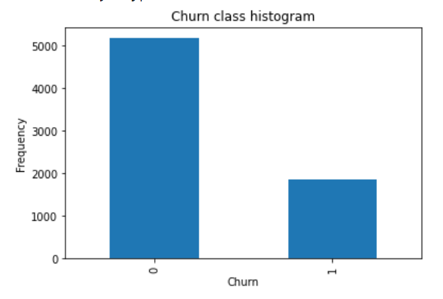
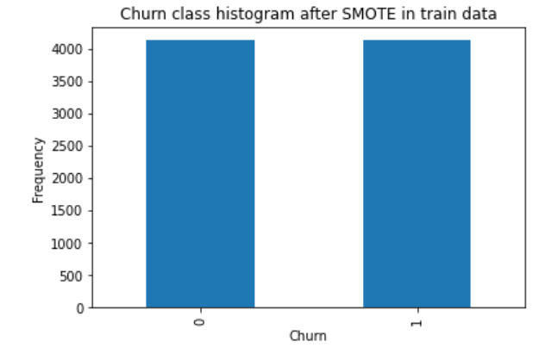
Churn variable before SMOTE: Churn variable after SMOTE

Slide 8
importances = model.feature_importances_
std = np.std([tree.feature_importances_ for tree in model.estimators_],
axis=0)
indices = np.argsort(importances)[::-1]
features = X_train_res.columns
for f in range(X_train_res.shape[1]):
print("%d. feature %d (%f) and feature name : %s" % (f+1 , indices[f],
importances[indices[f]], features[indices[f]]))
plt.figure(figsize=(15,10))
plt.title("Feature importances")
plt.bar(range(X_train_res.shape[1]), importances[indices],
color="r", yerr=std[indices], align="center")
plt.xticks(range(X_train_res.shape[1]), indices)
plt.xlim([-1, X_train_res.shape[1]])
plt.show()

Slide 9
From the feature ranking function we select the top 30 features out of the 47 features that we are using for model building:
Top 10 features of the total 30 features used for building models:
1. Tenure
2. Contract_Month-to-month
3. Contract_Two year
4. PaperlessBilling
5. OnlineSecurity
6. TechSupport
7. Contract_One year
8. Dependents
9. Partner
10. StreamingMovies

Slide 10
Model Building and assumptions:
We have built models on the SMOTE and standardized data
We are using the 30 features from the 47 features
We will build 4 different models – Decision Trees, Logistic Regression , Adaboost and Logistic Regression
Decision Tree:
We have used the scikit library for developing decision tree and our first tree model gives the following confusion tree for test data
from sklearn import tree
clf_dt = tree.DecisionTreeClassifier(random_state=9)
clf_dt = clf_dt.fit(scaled_train, y_train_res)
plt.figure(figsize = (15,10))
tree.plot_tree(clf_dt, filled = True)

Slide 11
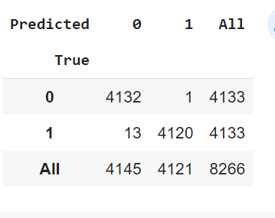
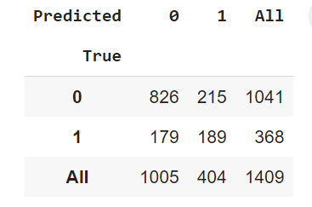
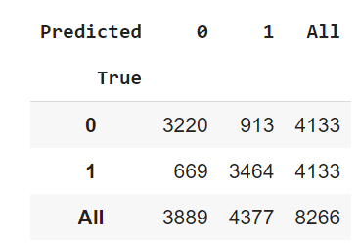
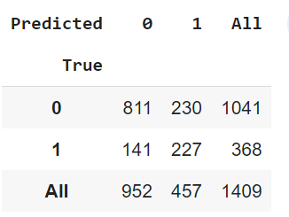
Confusion matrix for our first model We develop another model with max_tree depth = 4
This is a clear example of overfitting where we are just getting 14 mis-classified points for train data and for testing we have 394 mis-classified points
Here our model is making way too many mistakes in training set but in test set, we just have 374 points at depth = 4 which is better than our previous overfitted model.

Slide 12
Random Forest
For our random forest model we will built it using scikit learn
We have developed 5 random forest models and we are choosing the best model for our analysis
We have used the following parameters
Models | n-estimators | Max leaf nodes | Max features | Mis-classified points
Forest1 | 1000 | 7 | auto | 500
Forest2 | 1000 | 7 | auto | 517
Forest3 | 1200 | 10 | auto | 338
Forest4 | 1000 | 7 | log2 | 513
Forest5 | 700 | 7 | auto | 349

Slide 13
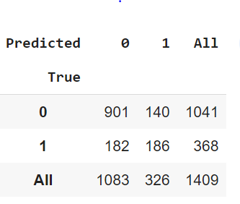
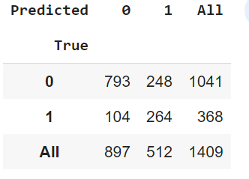
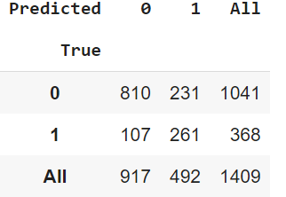
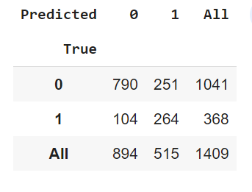
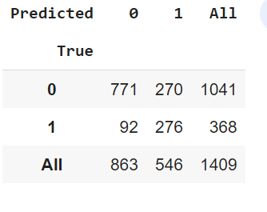
Confusion Matrix for different models:

Slide 14
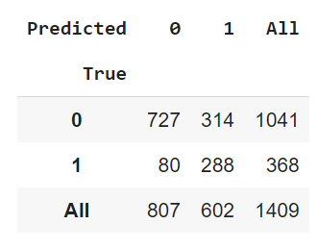
Logistic Regression
We built the logistic regression using scikit learn in the code given below:
parameters = {'C': np.linspace(0.001, 0.1, 1, 10)}
lr = LogisticRegression(random_state=9, max_iter=500)
clf = GridSearchCV(lr, parameters, cv=5, verbose=5, n_jobs=3)
clf.fit(scaled_train, y_train_res.ravel())
We have used different parameters like cross validation and verbose to reduce overfitting case after running we get the confusion matrix as:
For Basic LR model with 500 iterations we are getting best accuracy, but model is not able to classify churners well and is not appropriate. One thing to observe here is that low value of c is able to predict churners better !

Slide 15
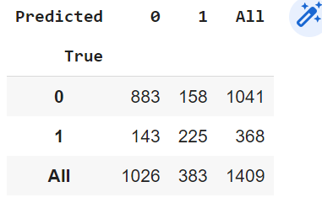
Adaboost Model
For running our adaboost model we use the following code
from sklearn.ensemble import AdaBoostClassifier
ada_clf = AdaBoostClassifier(random_state=9)
ada_clf.fit(scaled_train, y_train_res)
pred = ada_clf.predict(scaled_test)
confusion_matrix(y_test,pred)
pd.crosstab(y_test, pred, rownames=['True'], colnames=['Predicted'], margins=True)
We have not used any hyper parameter training but this model proves to be our best model

Slide 16
Model insights:
Decision Tree Model model has a fairly low accuracy in determining churning rate of the customer
Logistic regression model, which is overall slightly better performer in terms of predicting churners but it's miss-classification rate is too high.
Random Forest Model whose miss-classification rate for predicting churners is 3rd lowest and also overall mis-classification rate is also low.
Ada Boost Model whose miss-classification rate for predicting churners is 2nd lowest and also overall mis-classification rate is also lowest. Till this point, we have AdaBoostClassifier as best model with miss-classification of 351 points in total.
Based on our above analysis we proceed with Adaboost model for our deployment and we dump it using pickle
adaboost = pickle.load(open('adaboost.pkl', 'rb'))

Slide 17
Model Deployment
For our model deployment using Flask API we will create four functions
home() : It simply loads homepage.html when application is launched on port 127.0.0.1:5000.
get_data() : This function is responsible for fetching data from homepage.html. We used request.form.get() function to get values. Using all 47 features for which categorical value is 0 and later replaced them with 1 if they have been selected from drop down in our homepage.html. This function finally returns a dataframe with 1 for values which have been selected from drop-down and 0 for non-selected values.
feature_importance(model, data): As shown, function takes 2 arguments. In place of model, we will pass our adaboost model that we loaded and for data we will pass get_data() function as argument which will return above mentioned dataframe. With this, we calculate feature importance for top 30 values as I discussed above and return dataframe again with top 30 features.
min_max_scale(data): Takes data as an argument and we will pass feature_importance(). This function is a simple implementation of min-max scaler which I discussed earlier. This function would return dataframe with scaled values.
show_data(): In this function we call all the above created functions and finally pass outcome to results.html page to show our model’s prediction

Slide 18
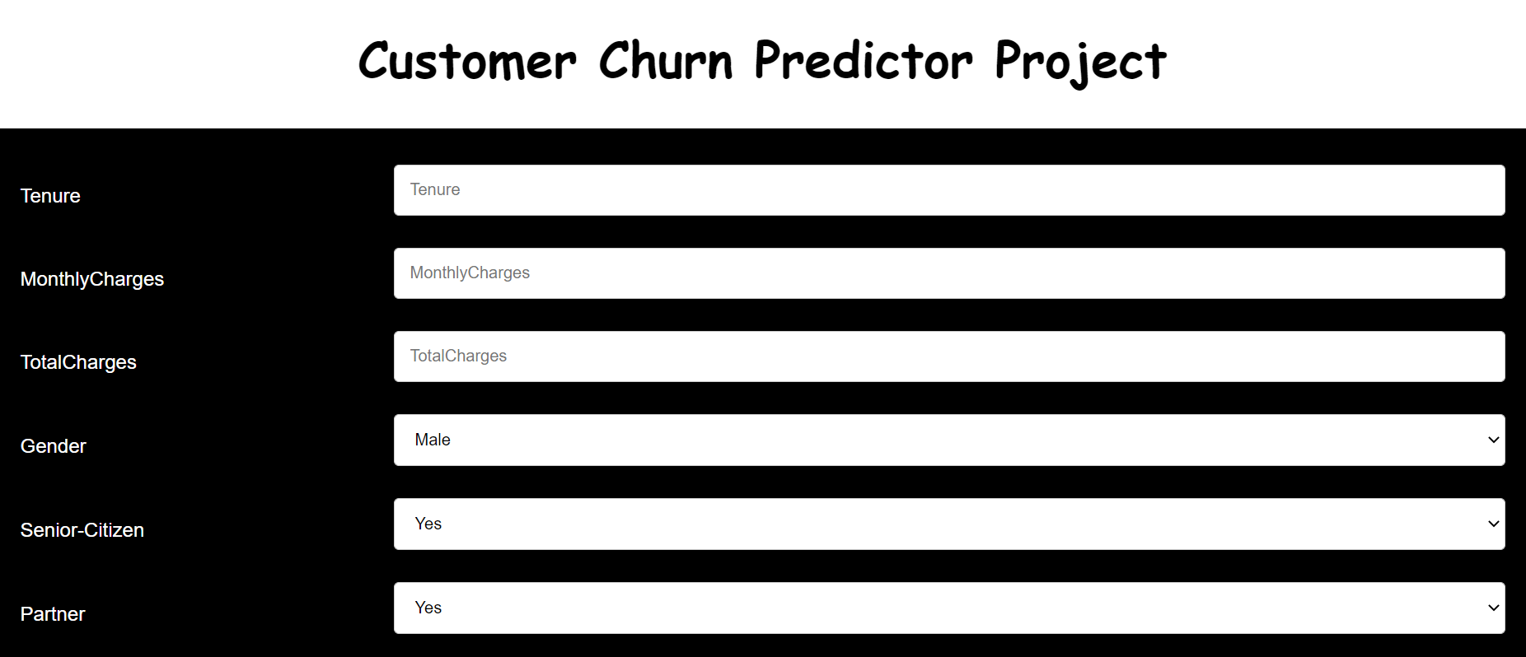
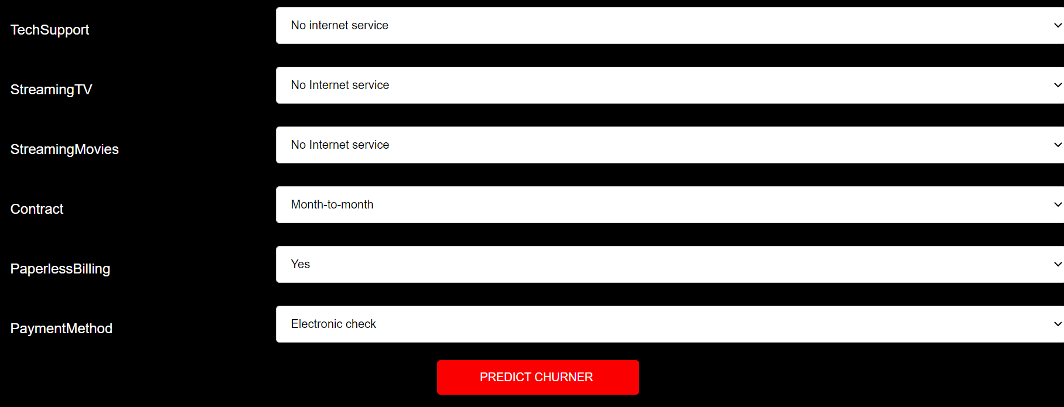
After Deployment we get the following home page as our result

Slide 19
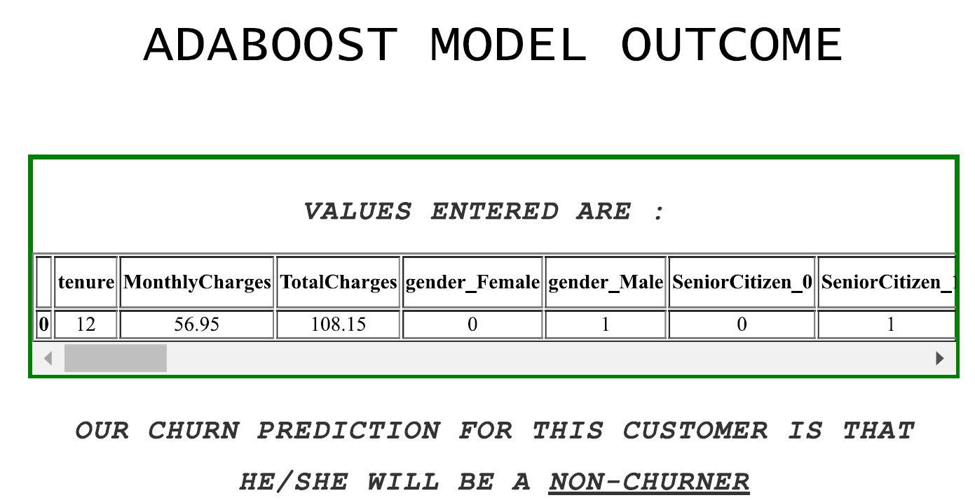
After deployment we the following prediction

Slide 20
THANK YOU

